Slide 1


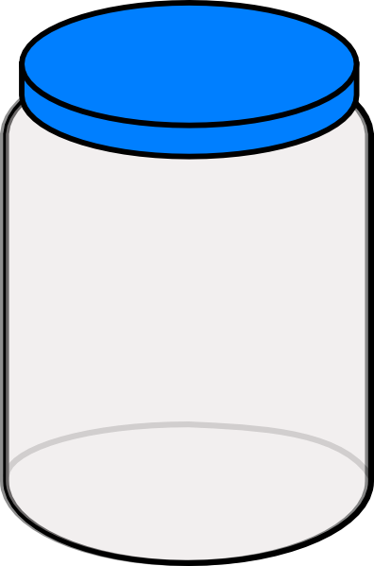





Caching Data in ASP.NET
Output Cache and Data Cache
SoftUni Team
Technical Trainers
Software University
http://softuni.bg

Slide 2


Table of Contents
What is Caching and How It Works?
OutputCache in ASP.NET
Client and Server Caching
Configuring the Caching
Partial Page Caching
Custom Data Caching
Using HtpContext.Cache

Slide 3



What is Caching and How It Works?
Caching Data to Boost Performance

Slide 4
What is Caching?
Caching data == store data in RAM or disk so future requests for that data can be served faster
The data stored in the cache is results of an earlier computation
Where caching is used?
CPU caches pieces of computer memory for faster processing
Hard disks cache data blocks to speed-up disk operations
Databases cache data tables to speed-up queries
Web browsers cache static resources like images

Slide 5




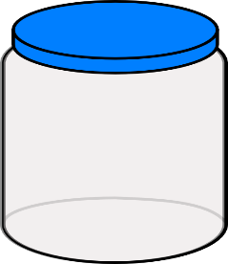
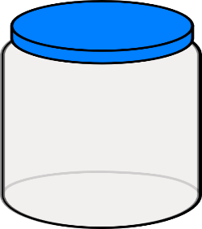


How the Cache Works in Web Apps?
Web Browser
Web Server
Database
HDD
Browser Cache
Server Cache
DB Cache
HDD Cache

Slide 6
Caching: Benefits and Costs
Benefits of caching
Improved performance
Speed – reduced response time and page load time
Efficiency – reduced infrastructure usage
CPU time, database utilization, network bandwidth
Costs of caching
Staleness (out-of-date)
Need to check and refresh data

Slide 7
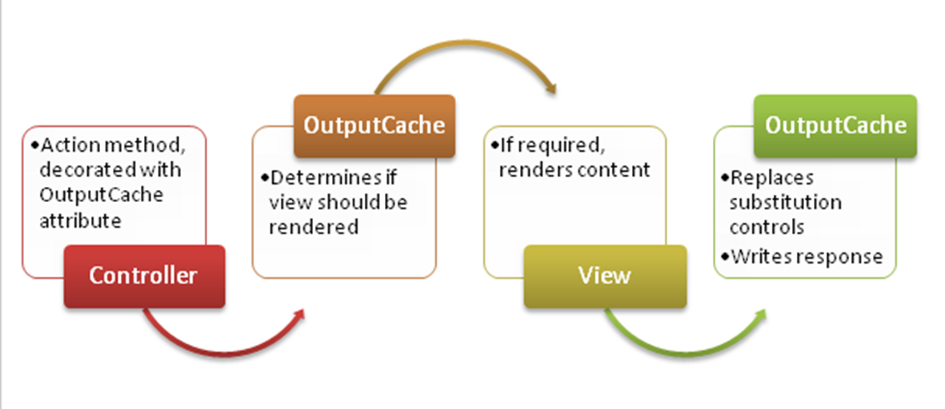
OutputCache in ASP.NET
Caching Controller Action's Output

Slide 8
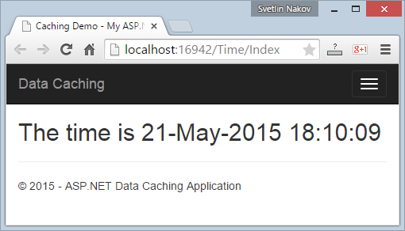
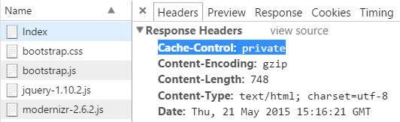
No Cache – Example
public class TimeController : Controller
{
public ActionResult Index()
{
return View();
}
}
@{
ViewBag.Title = "Caching Demo";
}
<h2>The time is @DateTime.Now</h2>

Slide 9
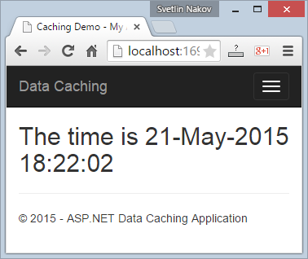

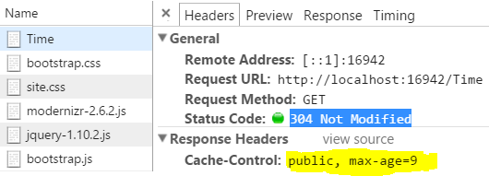
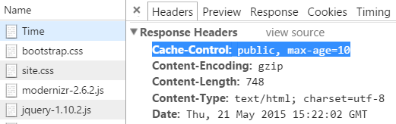
Caching for 10 Seconds – Example
public class TimeController : Controller
{
[OutputCache(Duration = 10, VaryByParam = "none")]
public ActionResult Index()
{
return View();
}
}

Slide 10
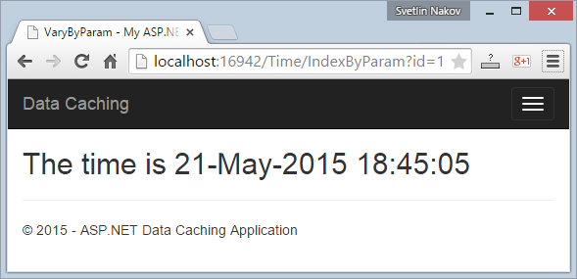
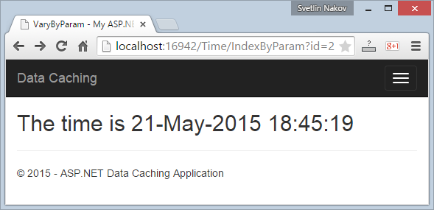
VaryByParam – Example
public class TimeController : Controller
{
[OutputCache(Duration = 3600,
VaryByParam = "id")]
public ActionResult IndexByParam()
{
return View();
}
}
@{ ViewBag.Title = "VaryByParam"; }
<h2>The time is @DateTime.Now</h2>

Slide 11
Cache Location
Any (default) – the content is cached in three locations:
the web server, any proxy servers, and the Web browser
Client – content is cached on the Web browser
Server – content is cached on the Web server
ServerAndClient – cached at the Web server + Web browser
Downstream – cached on the Web server + proxy servers
None – not cached anywhere

Slide 12
Cache Location Explained
Value | Cache-Control header | Expires header? | Cached on the server?
'Any' | public | Yes | Yes
'Client' | private | Yes | No
'Downstream' | public | Yes | No
'Server' | no-cache | No | Yes
'None' | no-cache | No | No

Slide 13
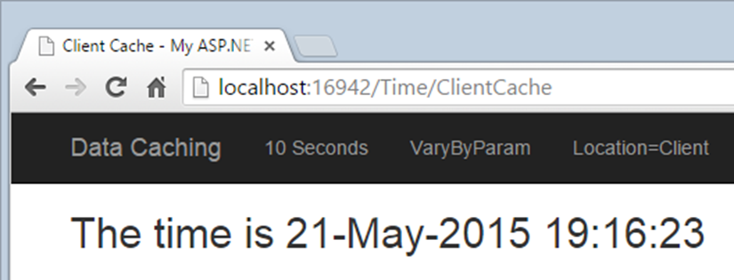
Cache Location – Example
public class TimeController : Controller
{
[OutputCache(Duration=3600, VaryByParam="none",
Location=OutputCacheLocation.Client)]
public ActionResult ClientCache()
{
return View();
}
}
@{ ViewBag.Title = "Client Cache"; }
<h2>The time is @DateTime.Now</h2>

Slide 14
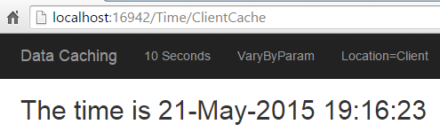

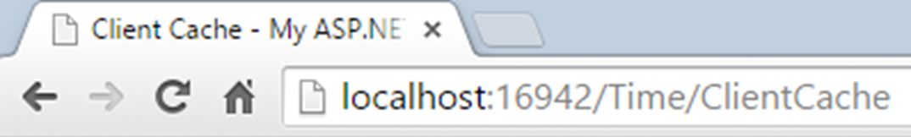
Browsers and Cache
Click on a link → loads the content again
No HTTP request for client-cached resources
[F5] / [Refresh] → requests the resource with the If-Modified-Since header
[Crtl+F5] / [Ctrl+Refresh]
[F5] / [Refresh] → requests the resource with no cache

Slide 15
Invalidate the OutputCache
Invalidate (remove) the cache for certain controller action
Only possible for server-side caching!
[OutputCache(Duration=3600, Location=OutputCacheLocation.Server)]
public ActionResult ServerCache()
{ return View(); }
public ActionResult ClearServerCache()
{
var urlToRemove = Url.Action("ServerCache", "Time");
Response.RemoveOutputCacheItem(urlToRemove);
return RedirectToAction("ServerCache");
}

Slide 16
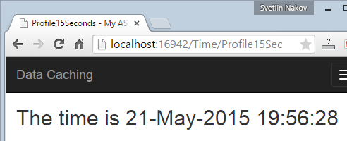
Cache Profiles in Web.config
<system.web>
<caching>
<outputCacheSettings>
<outputCacheProfiles>
<add name="Profile15Sec"
duration="15"
varyByParam="none"
location="Any" />
</outputCacheProfiles>
</outputCacheSettings>
</caching>
</system.web>
[OutputCache(CacheProfile =
"Profile15Sec")]
public ActionResult
Profile15Sec()
{
return View();
}

Slide 17
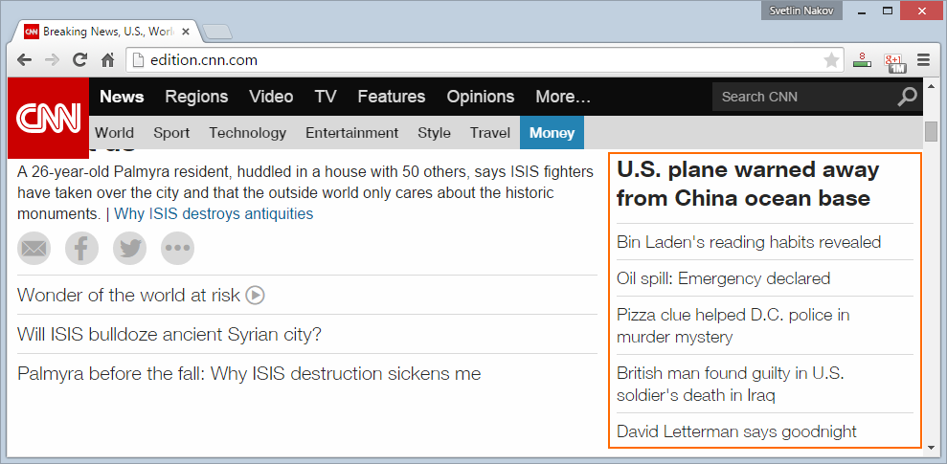
Partial Page Caching
Caching a Piece of Your Page

Slide 18
Partial Page Caching
Most pages consist of many pieces (divs / widgets)
E.g. header, footer, sidebar, news section, other widgets …
To boost performance
Cache the widgets that update rarely
Instead of caching the entire page
Example – a discussion forum
Cache the header, footer, top posts, top users, etc.
Do not cache the questions / answers / comments

Slide 19
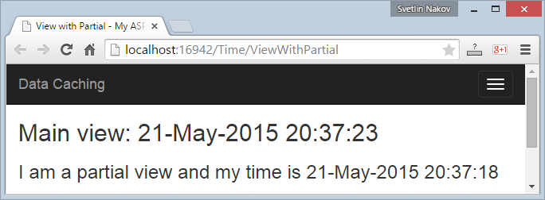
Partial Page Caching in ASP.NET MVC
TimeController.cs
ViewWithPartial.cshtml
public ActionResult ViewWithPartial()
{ return View(); }
[OutputCache(Duration = 10)] [ChildActionOnly]
public PartialViewResult PartialView()
{
return PartialView("_PartialView");
}
@{ ViewBag.Title =
"View with Partial"; }
<h2>Main view: @DateTime.Now</h2>
@Html.Action("PartialView")
_PartialView.cshtml
<h3>I am a partial view and my time is @DateTime.Now</h3>

Slide 20
Custom Data Caching
CUSTOM
CUSTOM
Using the Cache Object in ASP.NET

Slide 21
Data Caching in ASP.NET
You have a Cache object out of the box
It keeps cached data
Expires by certain configuration or manually
public ActionResult DataCache()
{
if (this.HttpContext.Cache["time"] == null)
{
this.HttpContext.Cache["time"] = DateTime.Now;
}
this.ViewBag.Time = this.HttpContext.Cache["time"];
return View();
}

Slide 22
Manually Invalidate the Data Cache
Items can be removed from the data cache:
Or can be scheduled for automatic removal (expiration):
public ActionResult InvalidateCache()
{
this.HttpContext.Cache.Remove("time");
return this.RedirectToAction("DataCache");
}
this.HttpContext.Cache.Insert("time", DateTime.Now,
null, Cache.NoAbsoluteExpiration, TimeSpan.FromMinutes(5));

Slide 23
Configuring the Data Cache Expiration
Example of setting cache entry parameters:
if (this.HttpContext.Cache["time"] == null)
{
this.HttpContext.Cache.Insert(
"time", // key
DateTime.Now, // value
null, // cache dependencies
DateTime.Now.AddSeconds(10), // absolute expiration
TimeSpan.Zero, // sliding expiration
CacheItemPriority.Default, // priority
null); // callback delegate
}

Slide 24
Cache Dependencies
Cache dependencies can ensure that data is not stale
Cache entry can be flushed when:
A file changes
A directory changes
Another cache entry is removed
Something in the database changes
E.g. SQL Server cache dependencies

Slide 25
Cache Dependencies – Example
public class FilesController : Controller
{
public ActionResult Index()
{
if (this.HttpContext.Cache["files"] == null)
{
var folder = Server.MapPath("~/Images");
var files = Directory.EnumerateFiles(folder);
this.HttpContext.Cache.Insert("files", files,
new CacheDependency(folder));
}
this.ViewBag.Files = this.HttpContext.Cache["files"];
return View();
}
}

Slide 26
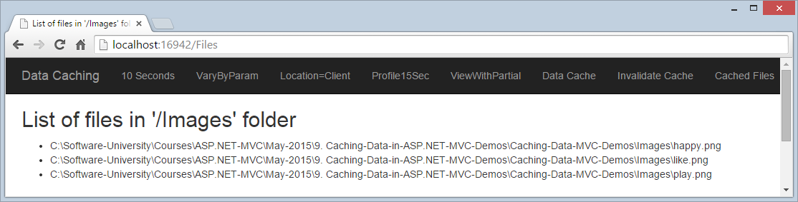
Cache Dependencies – Example (2)
@{ ViewBag.Title = "List of files in '/Images' folder"; }
<h2>@ViewBag.Title</h2>
<ul>
@foreach (var file in ViewBag.Files)
{ <li>@file</li> }
</ul>

Slide 27
Summary
Caching dramatically boosts performance and saves resources
Client-side caching (in the Web browser) is most efficient
OutputCache is ASP.NET MVC configures caching
Client side (bowser) caching and server-side caching
Partial page caching caches the areas of the site that change rarely
Caching can be controlled by hand
Use HttpContext.Cache object

Slide 28









Caching Data in ASP.NET
https://softuni.bg/courses/asp-net-mvc/

Slide 29
License
This course (slides, examples, demos, videos, homework, etc.) is licensed under the "Creative Commons Attribution-NonCommercial-ShareAlike 4.0 International" license
Attribution: this work may contain portions from
"ASP.NET MVC" course by Telerik Academy under CC-BY-NC-SA license

Slide 30




Free Trainings @ Software University
Software University Foundation – softuni.org
Software University – High-Quality Education, Profession and Job for Software Developers
softuni.bg
Software University @ Facebook
facebook.com/SoftwareUniversity
Software University @ YouTube
youtube.com/SoftwareUniversity
Software University Forums – forum.softuni.bg

